Slide 1

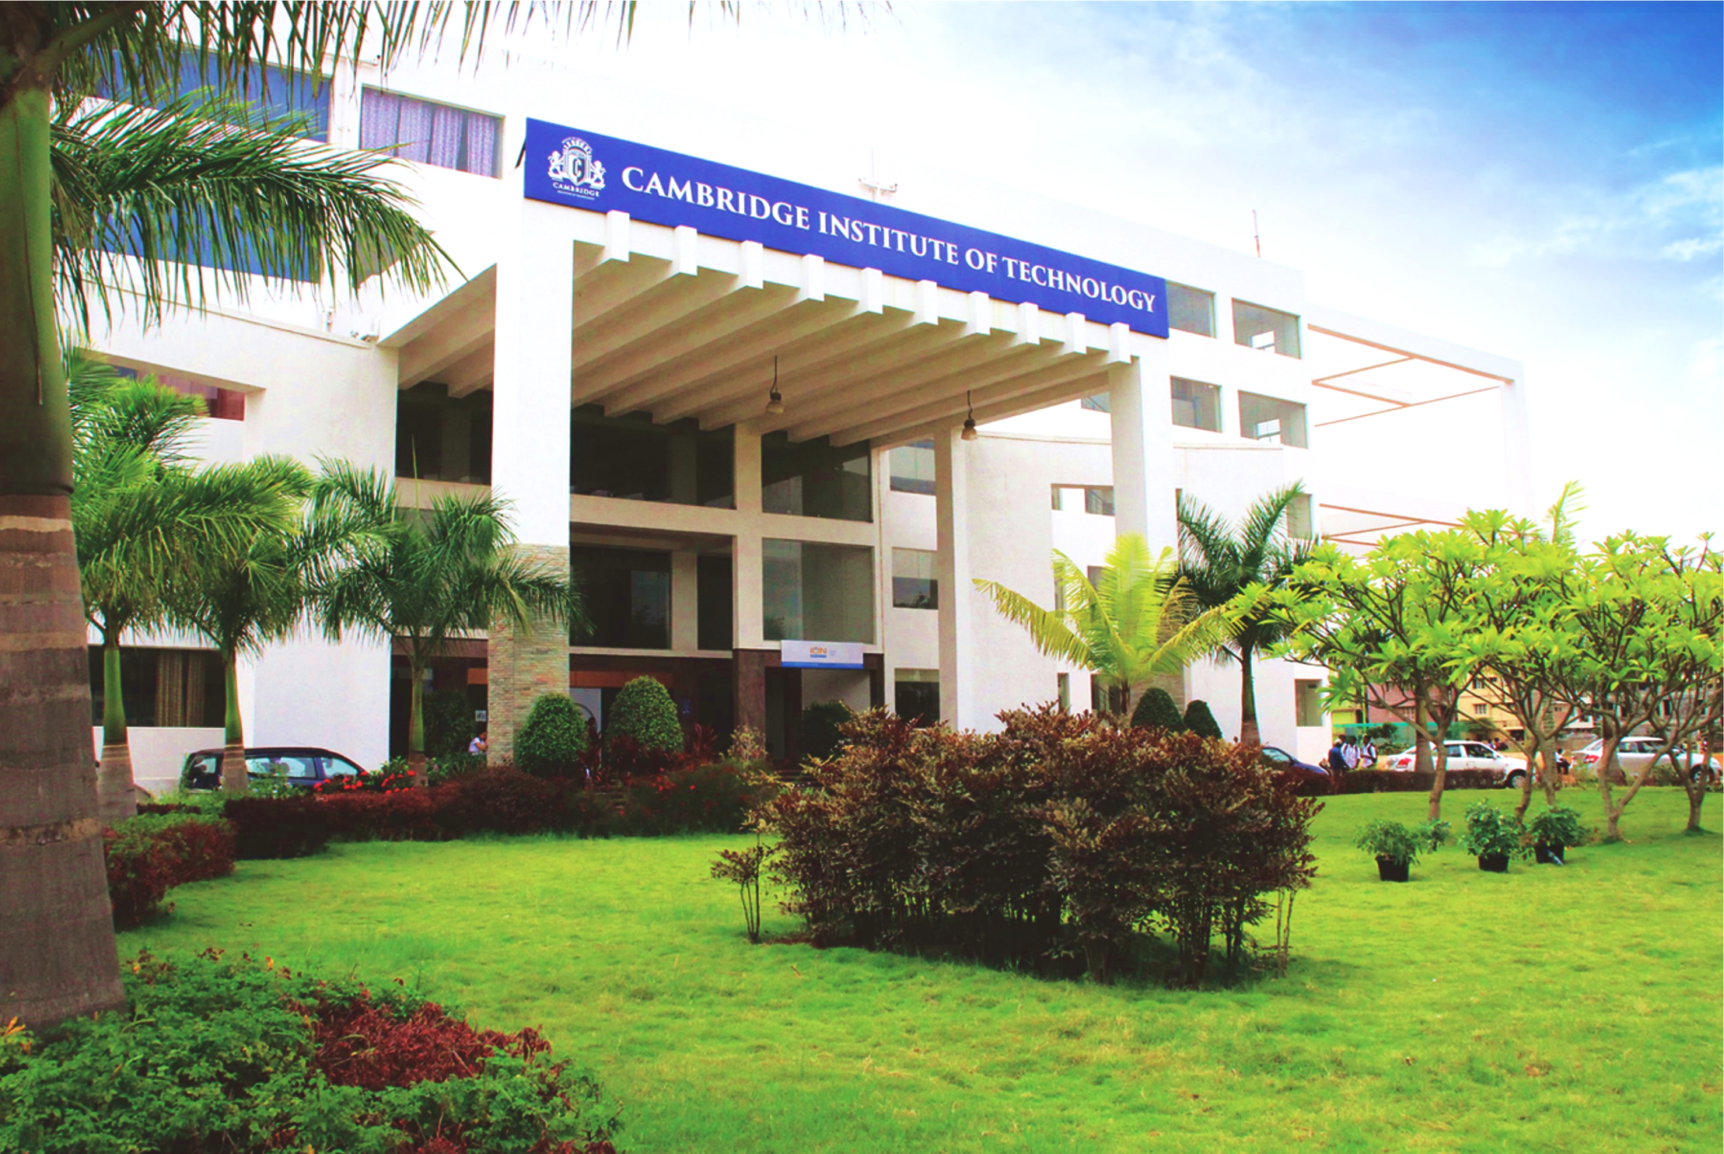
www.cambridge.edu.in
Machine Learning Mini Project
Subject Code:21AI63
Project Name : Poetry Generator and Creative Writing Tool using AI
Presented By :
x SAIKRISHNA K 1CD22AI404
NITHIN M 1CD21AI030
Department of Artificial Intelligence and Machine Learning

Slide 2
Abstract
The generation of high-quality, creative text remains a challenge, with existing models often requiring significant adaptation for artistic applications. This project proposes a fine-tuning approach for GPT-2 to develop specialized bots for poetry and creative writing. Leveraging GPT-2's advanced language capabilities, we train the model on diverse datasets of poems and creative texts to enhance its ability to produce engaging and contextually rich literary content. By adapting GPT-2 to these specific domains, our approach aims to improve the generation of imaginative and high-quality text, demonstrating significant advancements over standard language models in creative applications.
Department of Artificial Intelligence and Machine Learning www.Cambridge.edu.in

Slide 3
Introduction
This mini project focuses on creating specialized bots for poetry and creative writing by fine-tuning language models to generate artistic and imaginative text. It involves two main components: a poetry bot and a creative writing bot. The poetry bot, trained on a diverse dataset of poems, aims to produce rich and engaging poetry. The creative writing bot is fine-tuned on short stories and other creative texts to craft compelling narratives. While GPT-2 serves as the foundational model, the project emphasizes tailoring the model for these specific applications.
Department of Artificial Intelligence and Machine Learning www.Cambridge.edu.in

Slide 4
Problem Statement
"Develop an AI-powered tool to assist in the creation of poetry and creative writing, enhancing human creativity and productivity."
Department of Artificial Intelligence and Machine Learning www.Cambridge.edu.in

Slide 5
Objectives
Fine-tune GPT-2 to generate high-quality poetry from a diverse dataset of poems.
Adapt GPT-2 for crafting compelling narratives by training it on creative writing samples.
Evaluate the performance of the poetry and creative writing bots for creativity and coherence.
Demonstrate the practical applications of the fine-tuned models in generating literary content.
Department of Artificial Intelligence and Machine Learning www.Cambridge.edu.in

Slide 6
Literature Survey
SL NO | PAPER TITLE | JOURNAL NAME | DESCRIPTION | PROS | CONS
1 | Plug and Play Language Models: | Conference on Empirical Methods in Natural Language Processing (EMNLP). | A Simple Approach to Controlled Text Generation by Shauli Ravfogel et al. introduces a method for controlling GPT-2's output attributes, like sentiment and style, without retraining. This enables precise, efficient generation of tailored content, such as thematic or stylistic poems. | Enables control of GPT-2’s output attributes without retraining, improving flexibility and efficiency in text generation for specific needs. | Limited to modifying attributes during generation; may not fully capture complex, nuanced control over text output.
2 | Generative AI-Based Text Generation Methods Using Pre-Trained GPT-2 Model | International Journal of Data Science and Analytics | explores various techniques for enhancing text generation with GPT-2, including fine-tuning and prompt engineering, and evaluates their effectiveness in different applications | Provides comprehensive techniques for leveraging GPT-2, including fine-tuning and prompt engineering, with practical applications and evaluations, enhancing understanding and effectiveness of text generation methods. | May lack depth in specific technique details; effectiveness can vary based on implementation and context; potential challenges with evaluating text quality and coherence across diverse applications.
Department of Artificial Intelligence and Machine Learning www.Cambridge.edu.in

Slide 7
Software Requirements
Operating System: Windows 10 (64-bit)
Programming Language: Python 3.8
NLP Library: OpenAI's GPT-3 API or GPT-2 other NLP libraries (e.g., spaCy, NLTK),
Machine Learning Framework: scikit-learn or TensorFlow,
Web Framework: Flask or Django
Department of Artificial Intelligence and Machine Learning www.Cambridge.edu.in

Slide 8
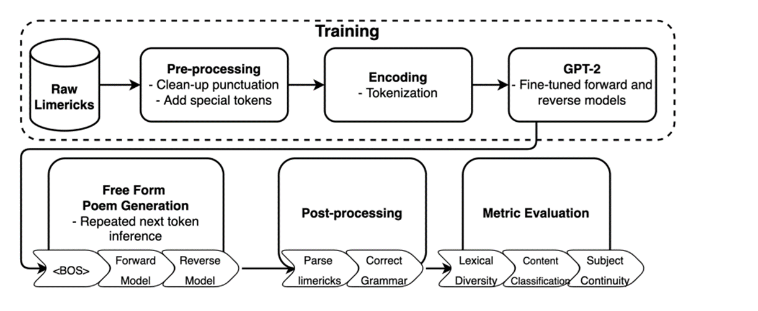
Methodology
Department of Artificial Intelligence and Machine Learning www.Cambridge.edu.in

Slide 9
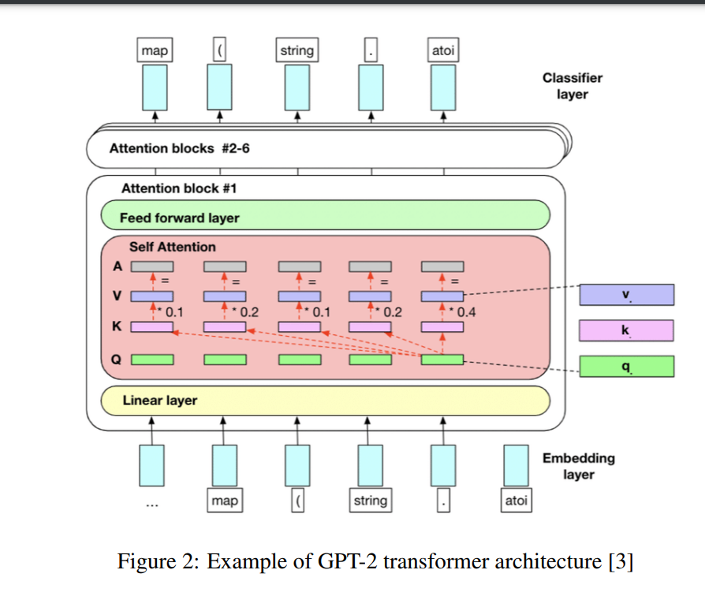
Architecture
Department of Artificial Intelligence and Machine Learning www.Cambridge.edu.in

Slide 10
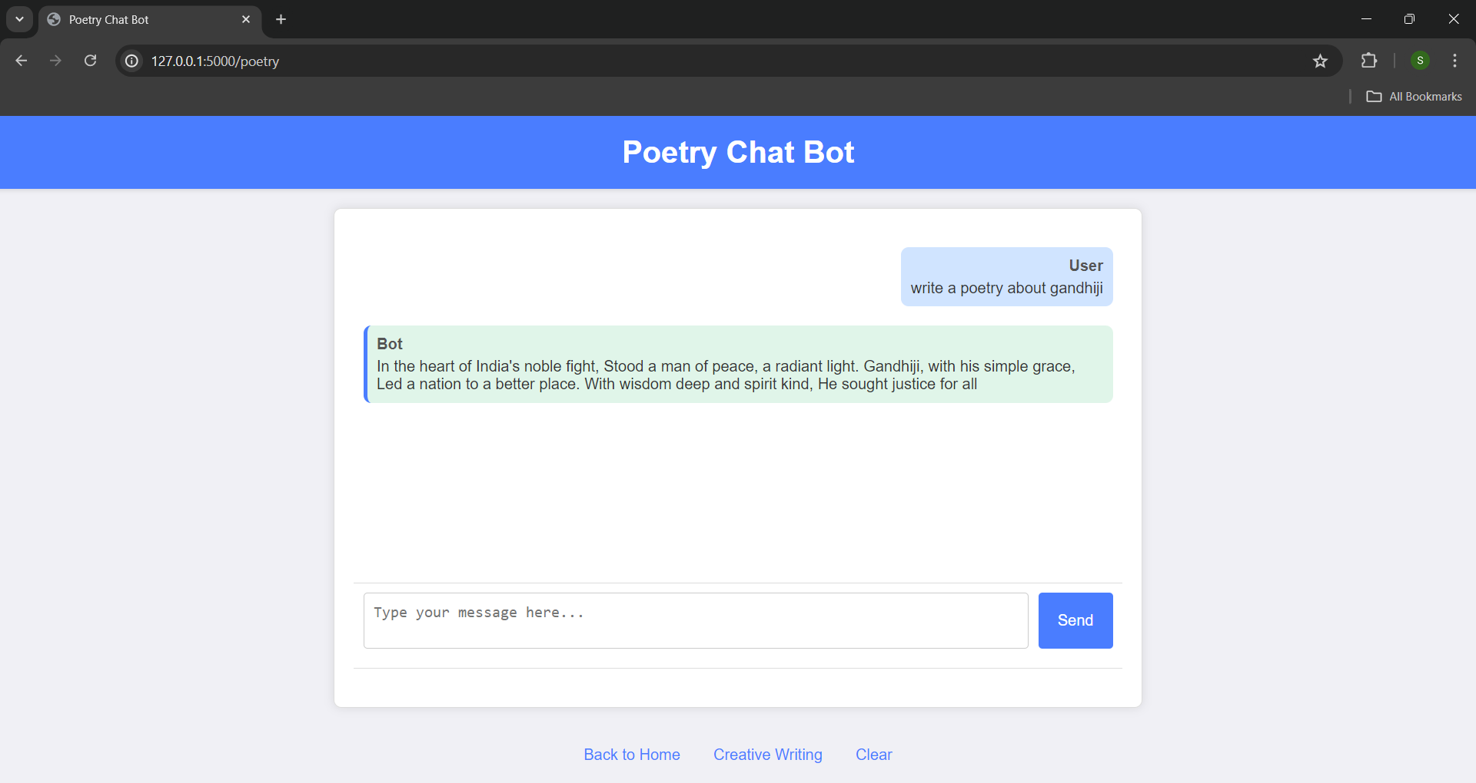
Results
Department of Artificial Intelligence and Machine Learning www.Cambridge.edu.in

Slide 11
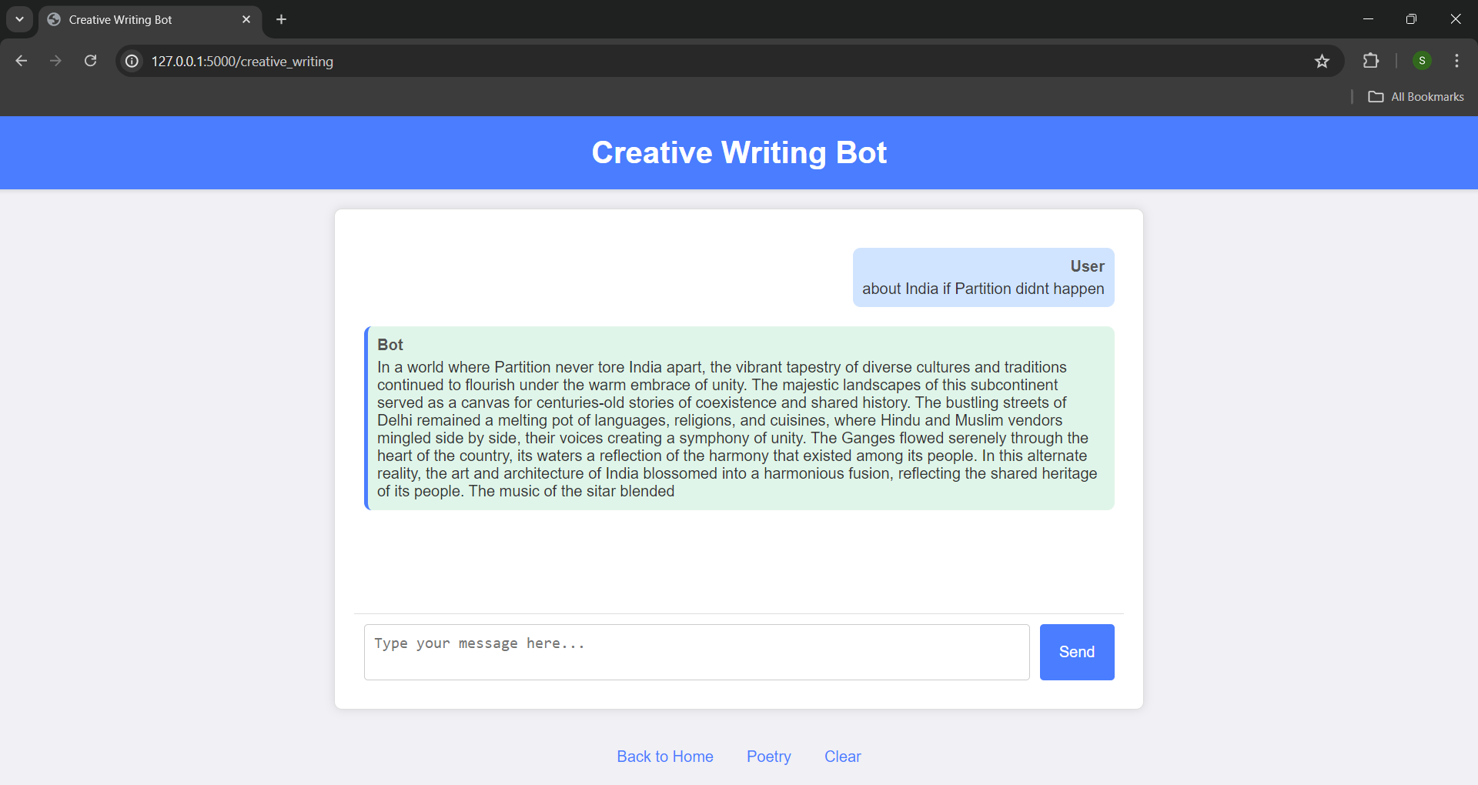
Results
Department of Artificial Intelligence and Machine Learning www.Cambridge.edu.in

Slide 12
Future Enhancement
Customization and Quality: Incorporate style transfer, complex prompts, and automated quality metrics for high-quality outputs.
Collaboration and Learning: Enable real-time collaboration and adaptive learning for co-creation and personalized refinement.
Multimodal and Interface: Integrate image and audio generation, develop a user-friendly interface, and optimize model performance.
Department of Artificial Intelligence and Machine Learning www.Cambridge.edu.in

Slide 13
Conclusion
The Poetry Generator and Creative Writing Tool marks a significant advancement in creative writing technology, effectively leveraging natural language processing and machine learning. It has proven adapt at generating coherent and contextually relevant content, offering valuable support to writers and poets. While successful, the field's ongoing evolution presents opportunities for enhancement, such as integrating advanced models and expanding data sources. This tool lays a foundation for future innovations, potentially transforming how writers approach their craft and enhancing the creative process worldwide.
Department of Artificial Intelligence and Machine Learning www.Cambridge.edu.in

Slide 14
References
[1] OpenAI API Documentation, OpenAI API
[2] Plug and Play Language Models: A Simple Approach to Controlled Text Generation
[3] Dataset retrieved from https://www.kaggle.com/datasets/michaelarman/poemsdataset
[4] Wolf, T., et al. (2020). Transformers: State-of-the-art natural language processing. In Proceedings of the 2020 Conference on Empirical Methods in Natural Language Processing: System Demonstrations. Retrieved from https://arxiv.org/abs/1910.03771
[5] OpenAI. (2023). GPT-2: Language model. Retrieved from https://openai.com/research/gpt-2
Department of Artificial Intelligence and Machine Learning www.Cambridge.edu.in

Slide 15
THANK YOU
Department of Artificial Intelligence and Machine Learning www.Cambridge.edu.in

